Slide 1
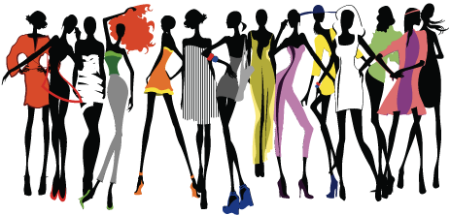
FASHION SHOW
4.A

Slide 2
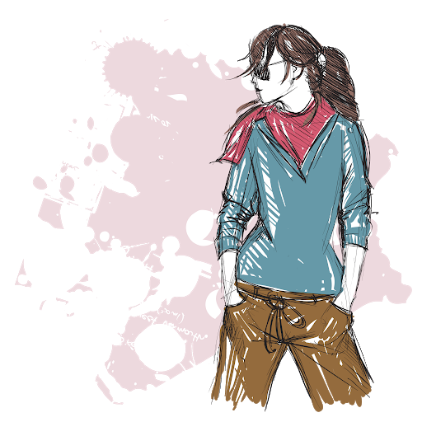
8 girls
16 outfits
1 show

Slide 3
Two categories
1.outfit = casual, basic, clothes that I prefer to wear and feel good in
2.outfit= crazy, for a special occasion, extravagant (what am I even wearing?)

Slide 4
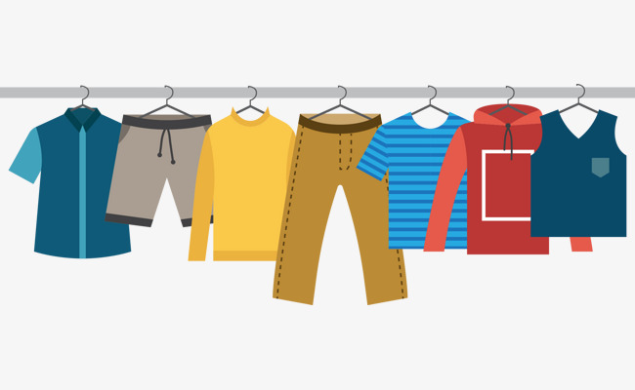
FIRST OUTFIT

Slide 5
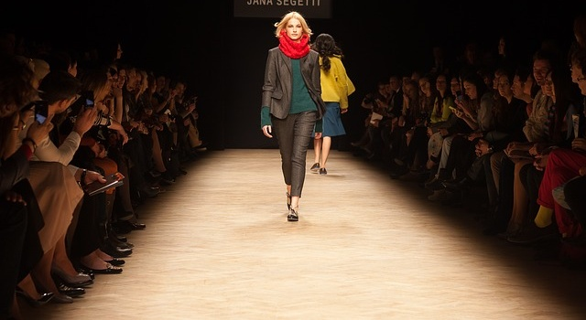
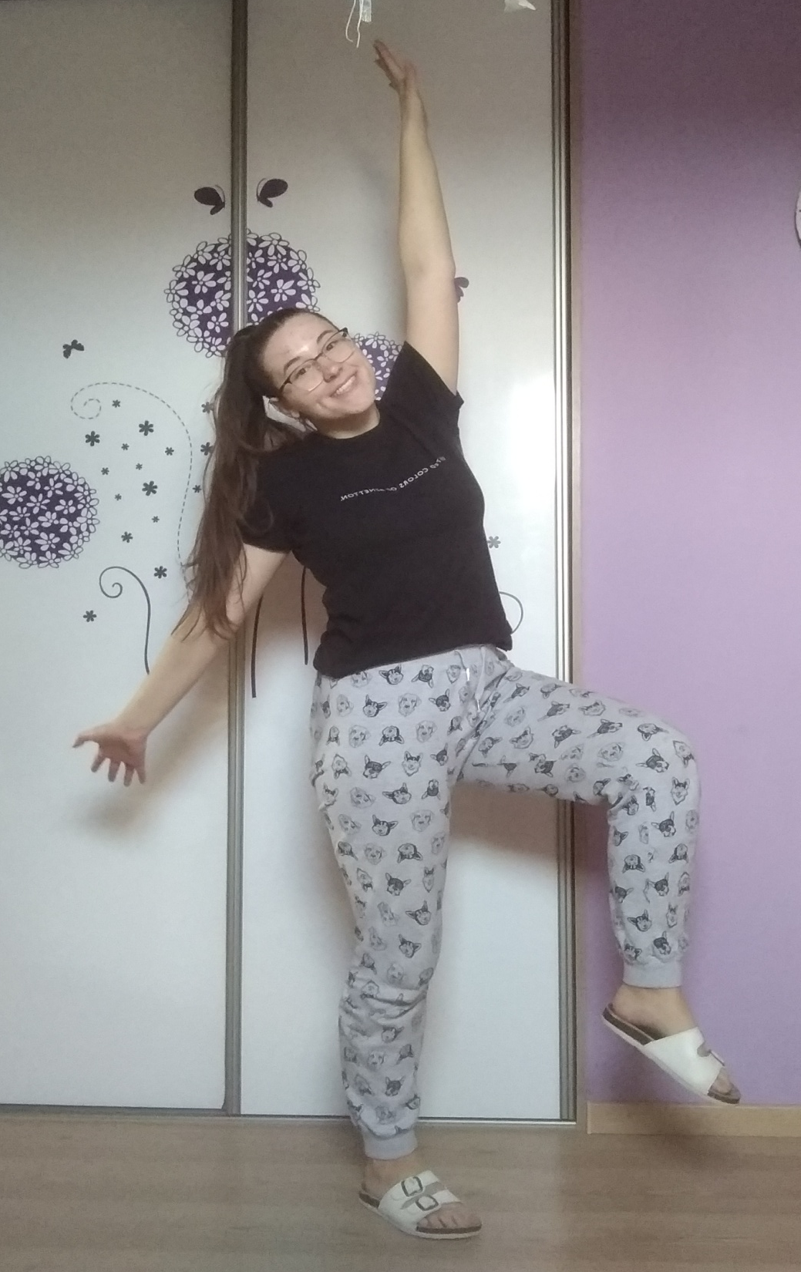
In the picture I can see myself.
I am wearing black T-shirt and grey sweatpants with dogs.
I usually wear white slippers. This is my typical „home clothes“.

Slide 6
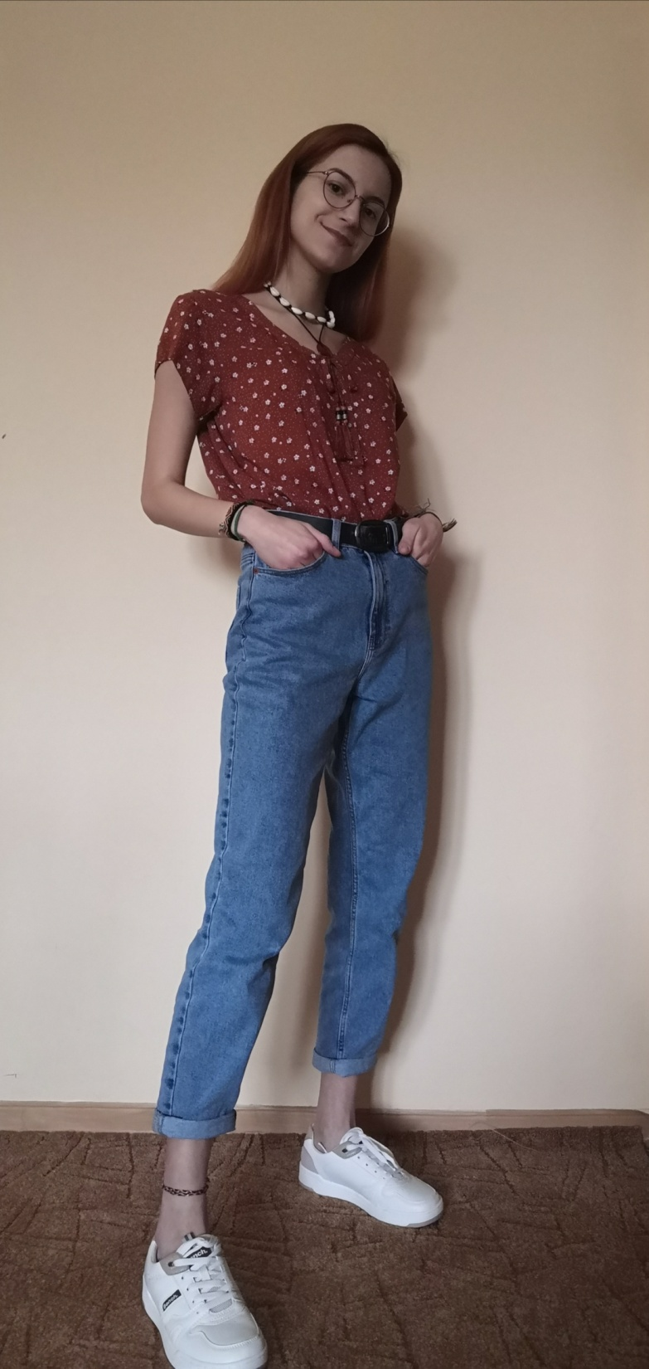
In this picture I am wearing floral blouse - orange colour with small white flowers, mom jeans with black belt and white sneakers on my feet. I complemented it with a carneol necklace, which colour matched with blouse. This outfit we can wear to school, or when we go out with friends, or party.

Slide 7
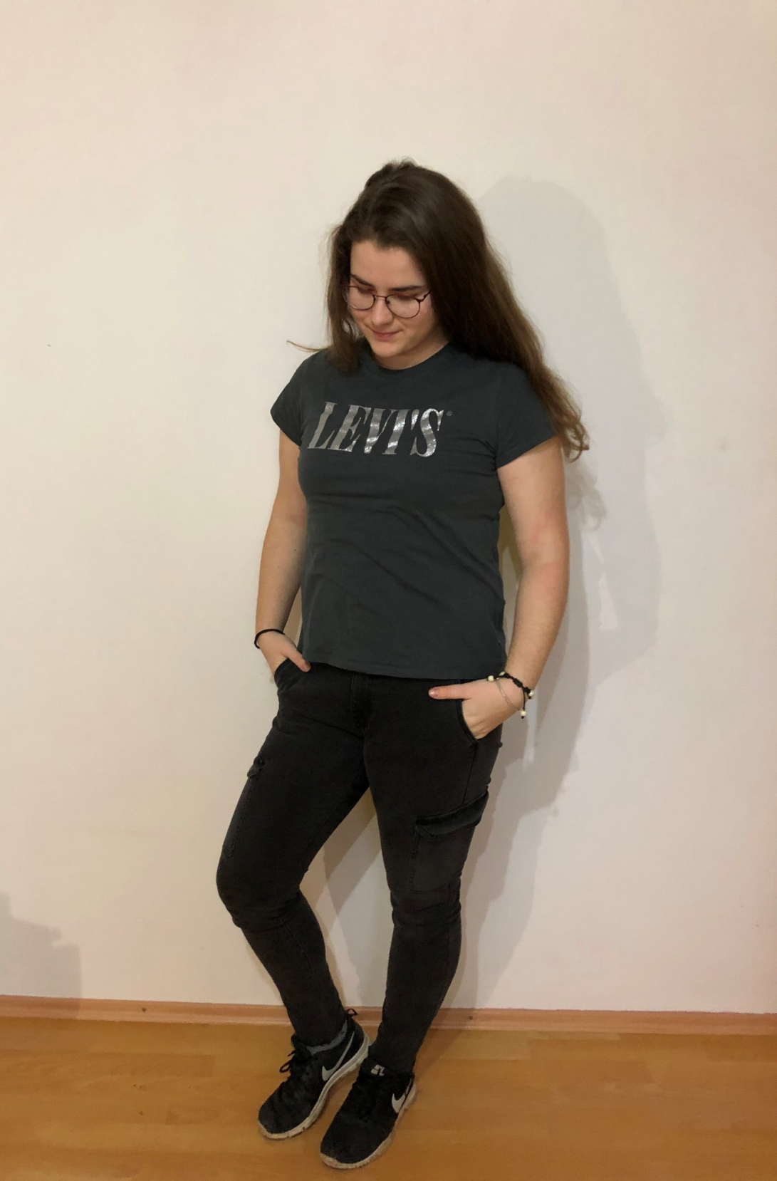
My favorite outfit consists of a simple sports t-shirt and comfortable jeans.
This type of clothing is my favorite because I don't like provocative and extravagant clothing. After all, there is beauty in simplicity.

Slide 8
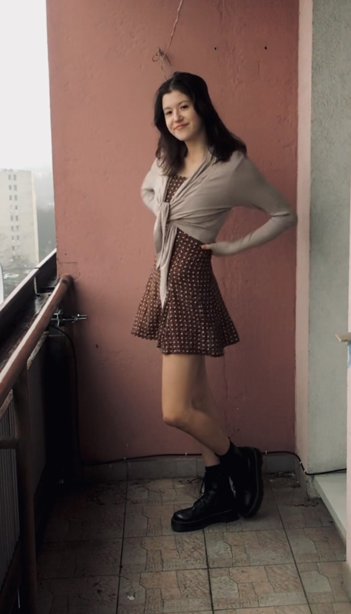
In the picture Im wearing brown dress with small white flowers on them, beige wrap up cardigan and black boots with platform.

Slide 9
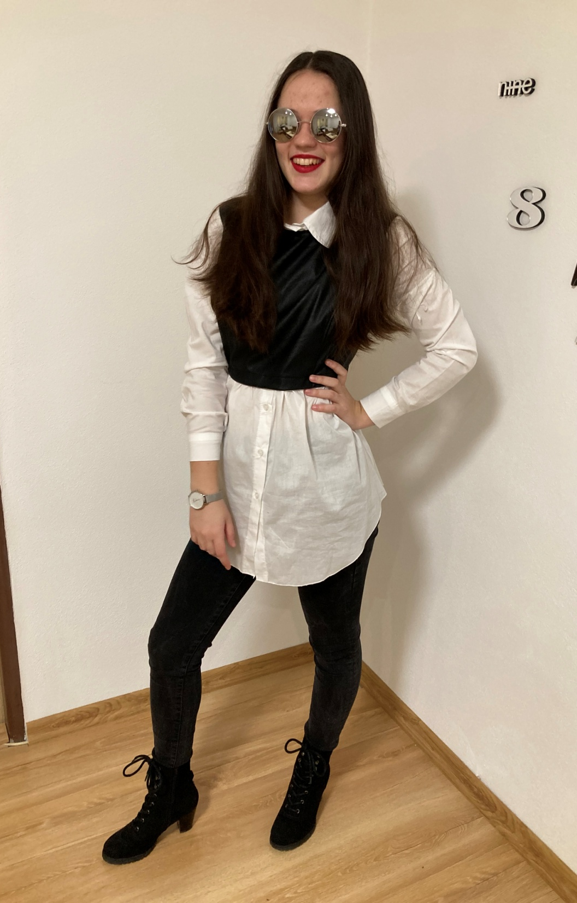
The model is wearing white shirt with black vest. She is wearing black jeans. She has high heels on her feet.
The model tuned the outfit with sunglasses and a watch. She wears this outfit when she goes out with her friends.

Slide 10
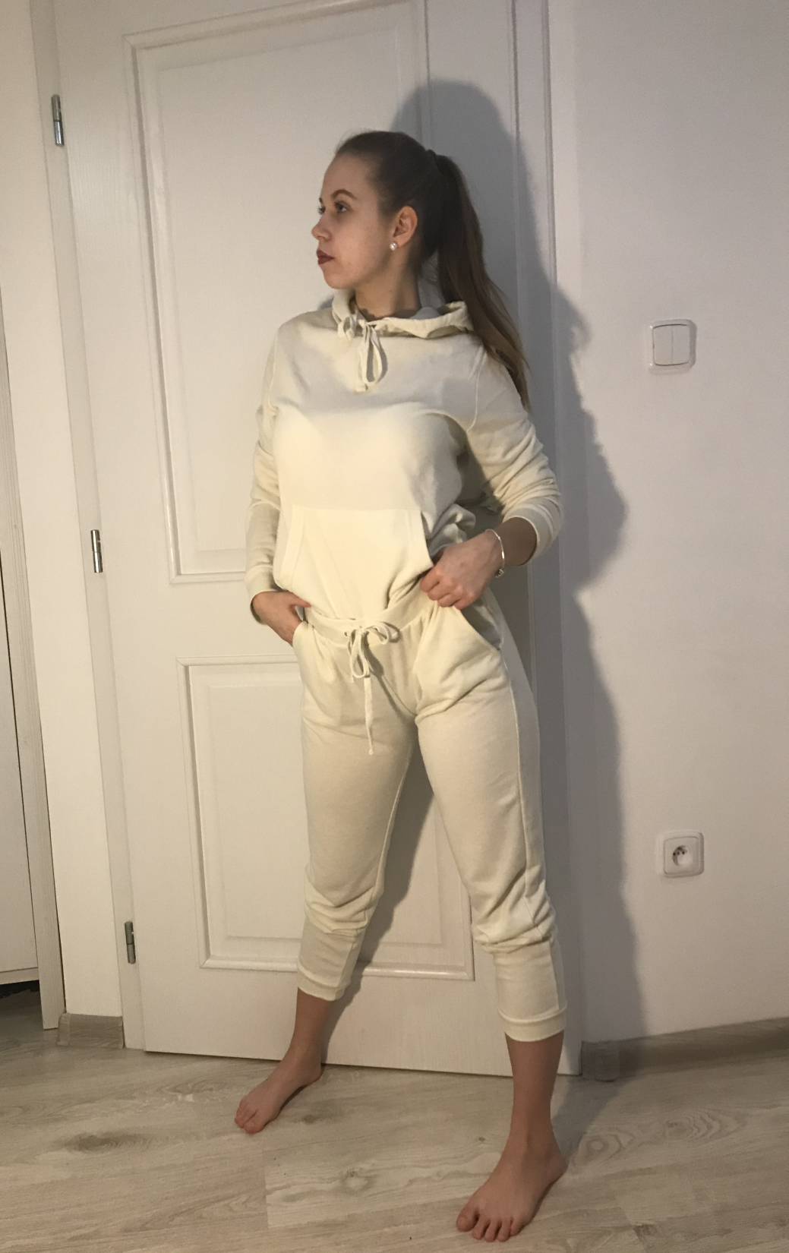
My casual outfit consist of sweatshirt and sweatpants which are really confortable and soft. Actually, this is outfit Im wearing everdy day nowdays. Im wearing my favorite earings in the shape of rings and I have my bracelet made of silver. As you can see Im have no boots bcs I love to go barefoot.

Slide 11
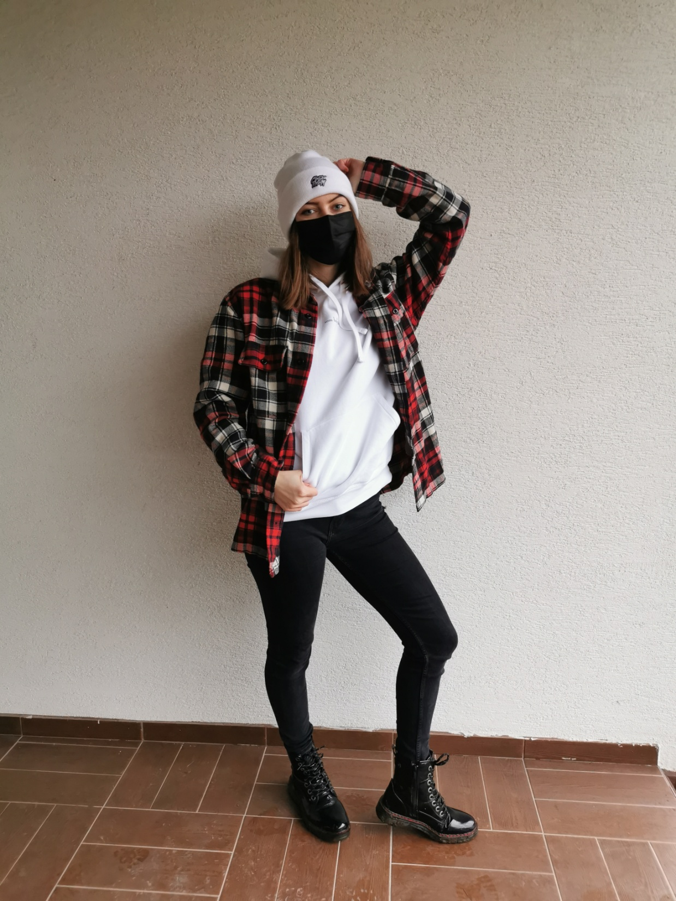
I am wearing black jeans, a white hoodie from my favorite influencer Emma Muller and a red flannel shirt on the hoodie. I have a warm white beanie on my head and I have wearing winter shiny boots.
Since I like to wear this outfit outside I also have a mask on my face because
of protection.

Slide 12
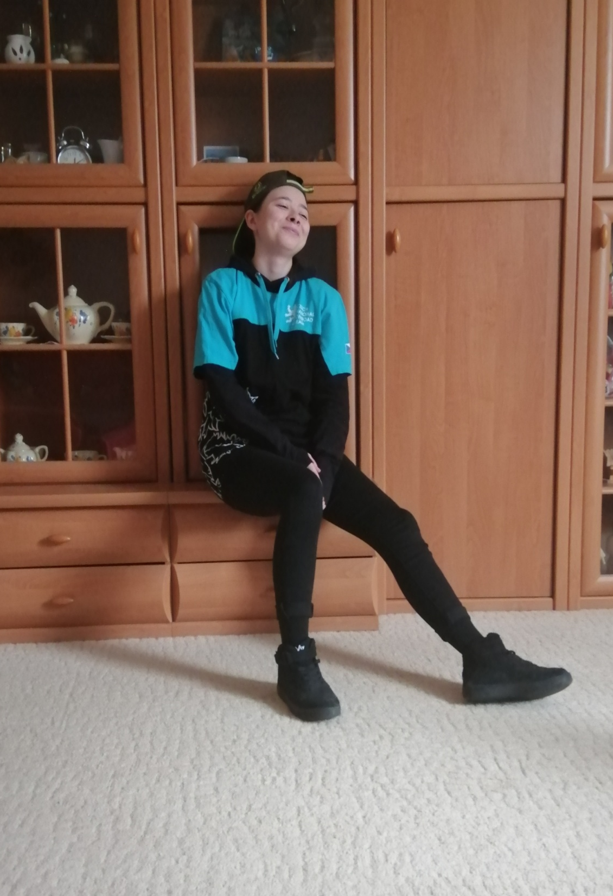
In the picture I am wearing black jeans, black socks and black sneakers. I am wearing black hoodie and black and blue T-shirt on hoodie. And on my head I am wearing a cap. This is my normal outfit for school or for shopping or for going out with friends.

Slide 13
SECOND OUTFIT

Slide 14
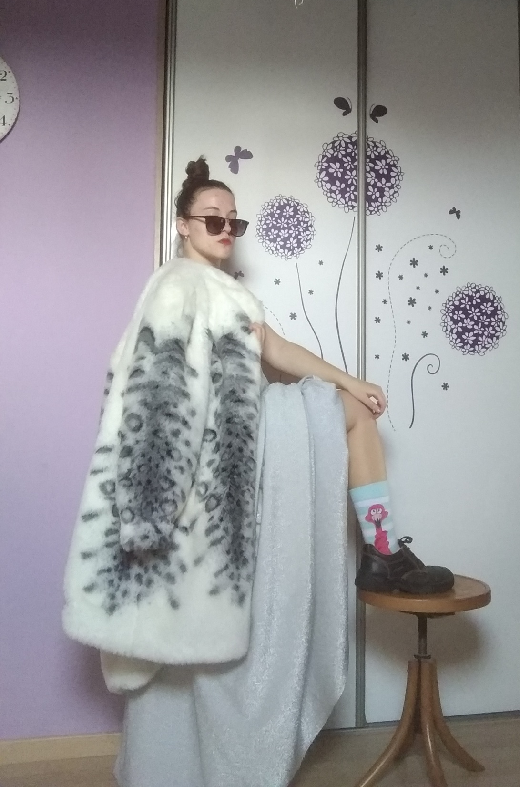
In the picture I can see a lady, who is wearing sunglasses, white coat with leopard design, silver ball dress with glitters, blue socks with crazy picture of flamenco and black ,,working,, shoes. This is my uniform when a I go to garden.

Slide 15
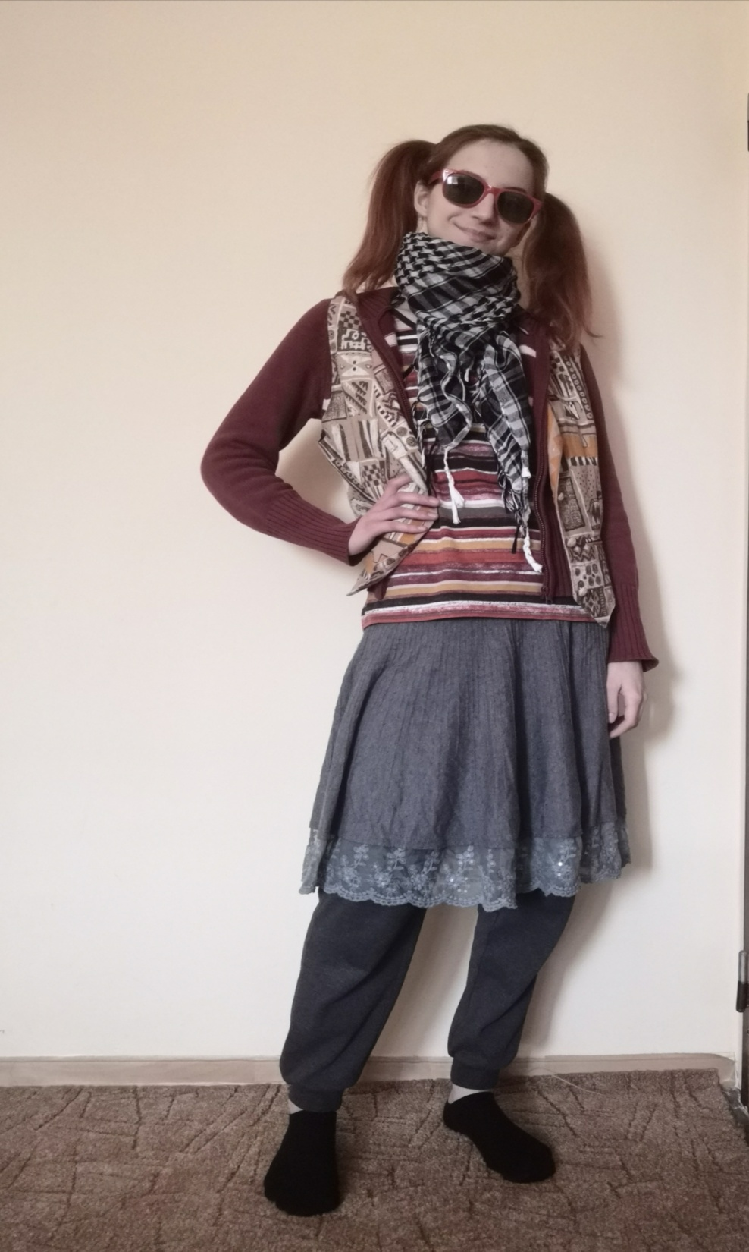
This outfit is the perfect homemade outfit. In this picture
I am wearing striped t-shirt, sweater and patterned waistcoat. So I don't get cold, when I will hang out. On my legs I have gray tracksuit and gray skirt.
I complemented it with a carted scarf and red sunglasses, to the sun doesn't keep me from working. I made two high ponytails to my hair didn't fall into my eyes when I will do house works. We can go throw out the trash in this outfit too.

Slide 16
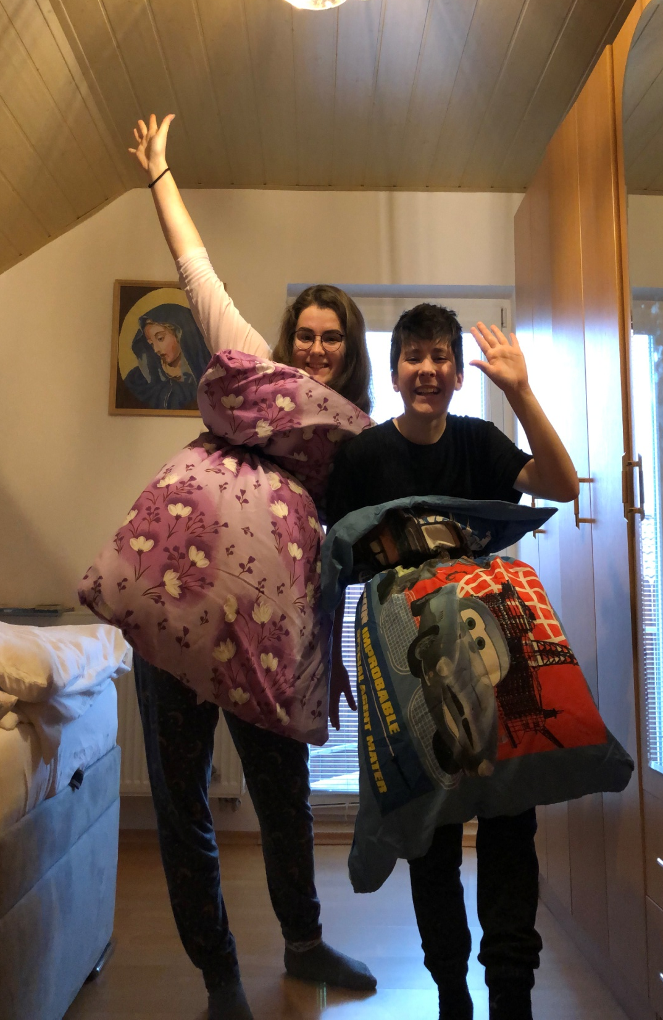
As a crazy outfit, we chose this one, which we called "in the embrace of lockdown". This outfit completely captures our everyday life, because we mostly wear pajamas and lie in bed. I also involved my brother in this challenge and we had a lot of fun

Slide 17
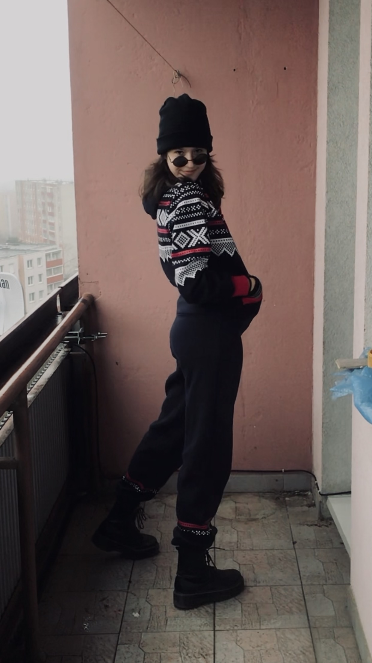
In the picture Im wearing my pyjamas overall with what i would call - christmas pattern, black beanie, grey gloves, sunglasses and my black boots again because balcony is wet

Slide 18
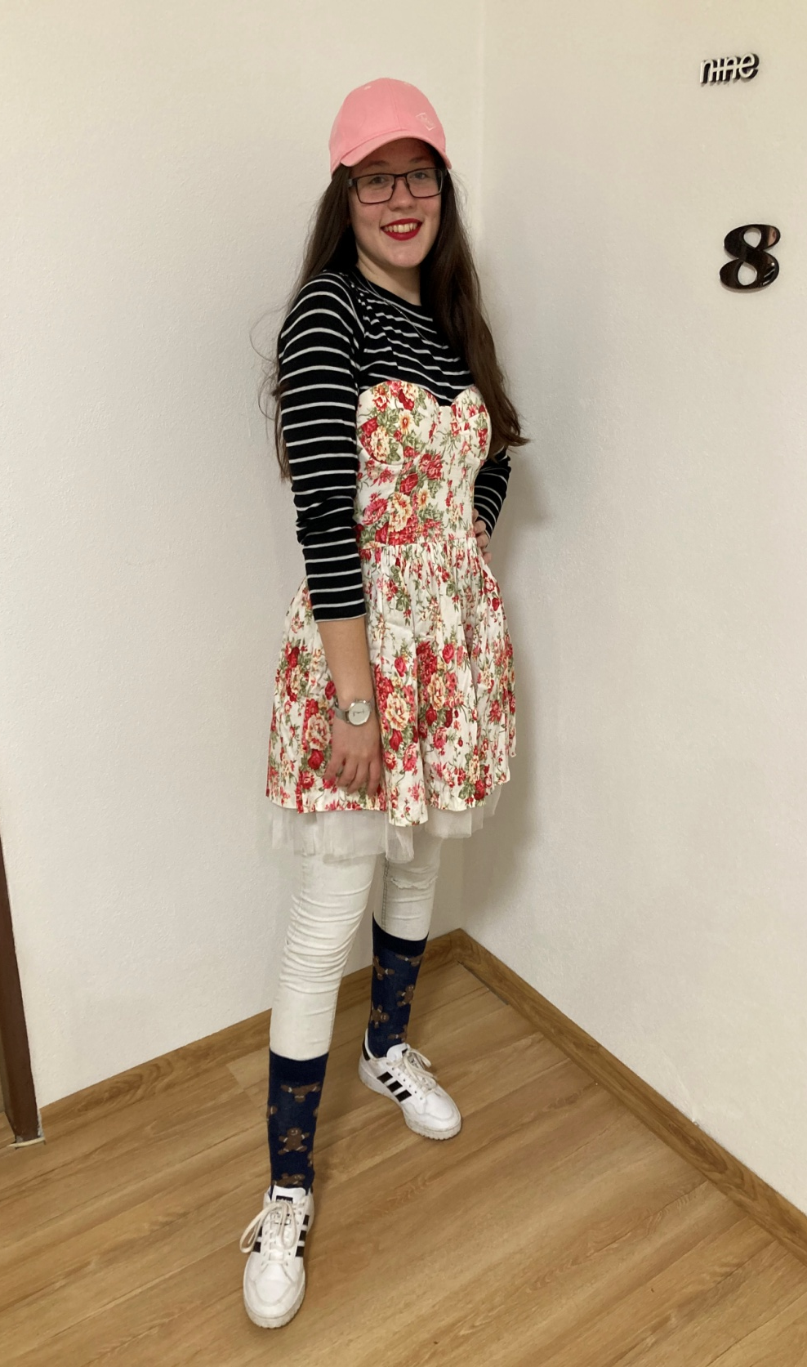
The model is wearing black striped t- shirt with long sleeves and white jeans. On top she is wearing small flowery dress. She has dark blue high socks in low white sneakers. She has a pink cap on her head.
She wears this outfit when she is at paris fashion week.

Slide 19
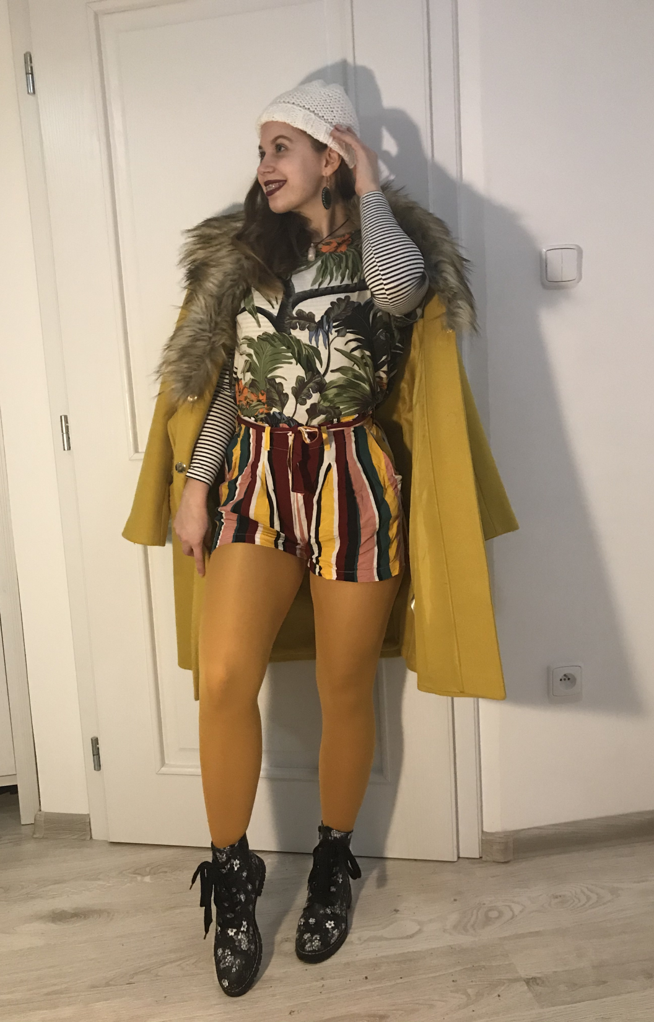
Lets start with the head.
Im wearing woolen hat (by the way its designed and knitted by my mom). Then i have green earings made of wood.
Im wearing yellow coat with fur.
Under the coat I have 2 t-shirts. One is striped with long sleeve and second with floral pattern with short sleeve. Then I have colourful shorts with stripes with belt and yellow stockings (i hate stockings but this one are really comfy) And the last piece of my outfit are black boots with floral pattern.

Slide 20
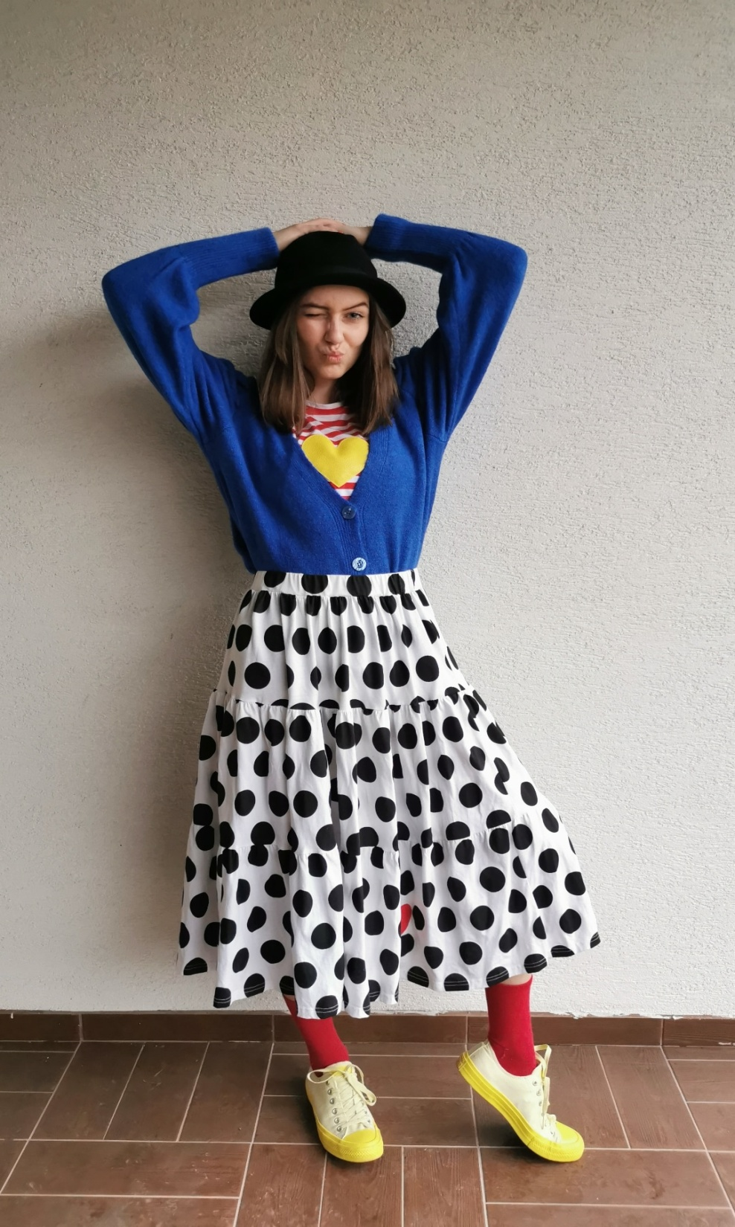
I am wearing a black and white dotted skirt and red and white striped T-shirt with a yellow heart. I have a blue sweater with large sleeves on my T-shirt.
I am wearing a black hat on my head. I have yellow sneakers in combination with red socks.
I recommend this outfit for people who are not afraid to untie themselves and make fun of themselves.

Slide 21
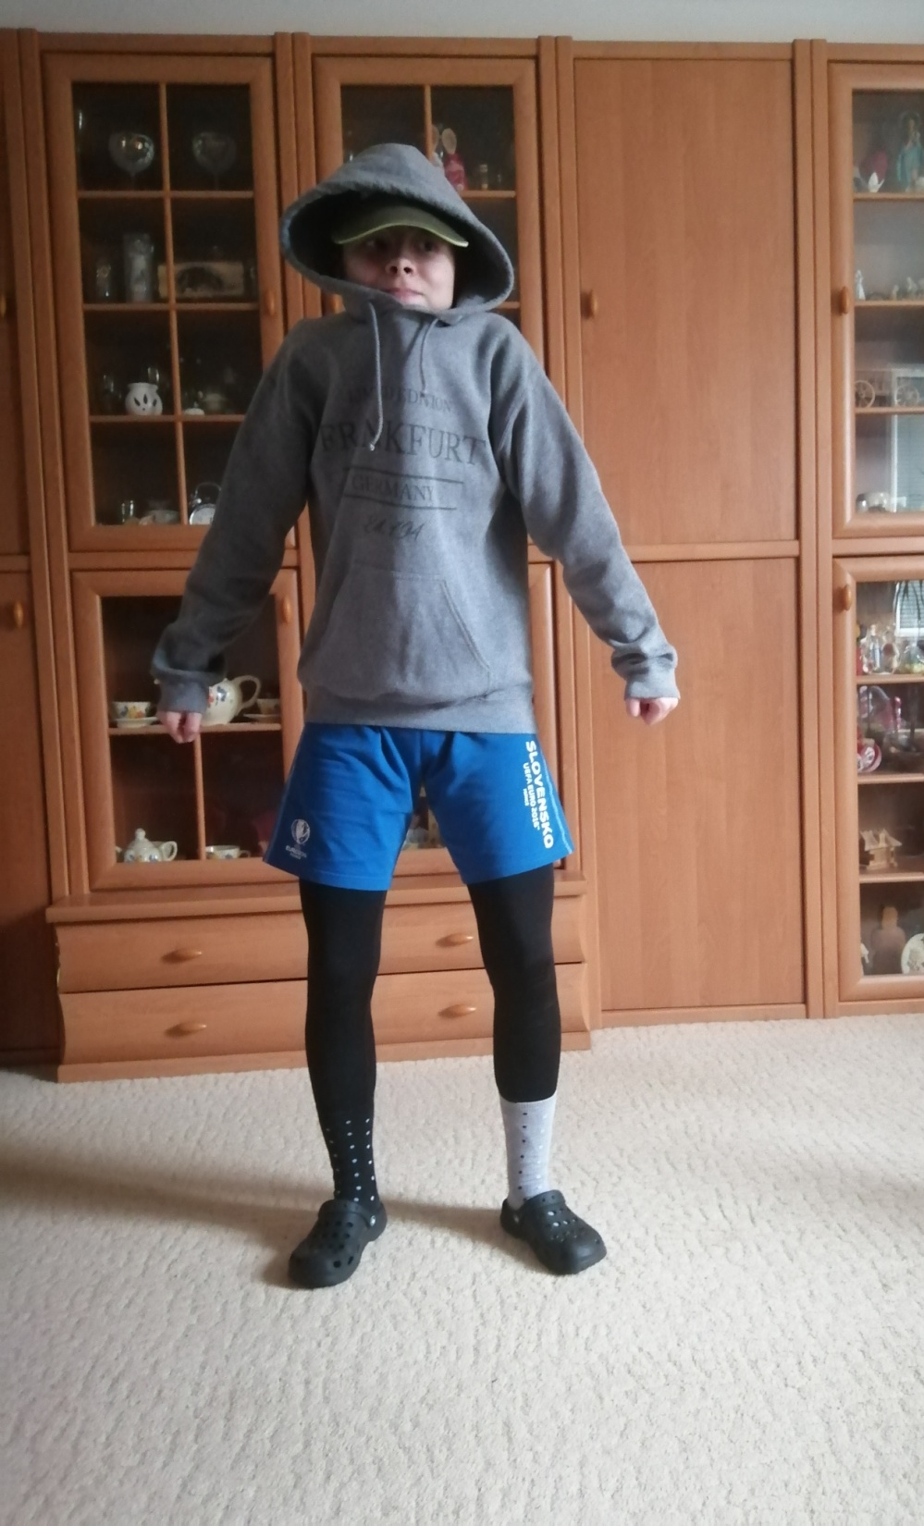
In the Picture I am wearing big grey hoodie. I am wearing black legins and blue shorts on
legins.I am wearing crocs slippers.And on my head can be nothing but a cap because I love it.I am wearing one black sock and one grey sock with black, white and blue dots to match colors with whole my outfit. For someone is this outfit crazy but this is my normal outfit witch I wear at home every day.

Slide 22
And now.....
ENJOY A FASHION SHOW!!!

